Slide 1
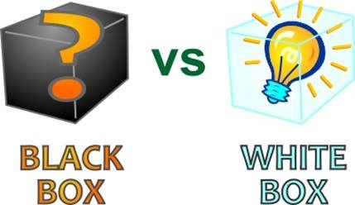
LET’S LEARN TESTING TECHNIQUES
CSEN-3202
CSE, Sec-B
Nilina Bera

Slide 2
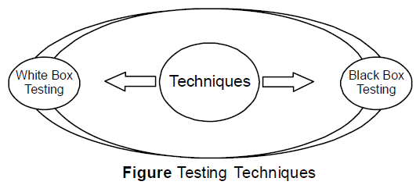
TESTING TECHNIQUES
Once the software is developed it should be tested in a proper manner before the system is delivered to the user. For this, two techniques that provide systematic guidance for designing tests are used under Unit Testing…...
White box ➔ Structural; Black Box ➔ Functional
Nilina Bera

Slide 3
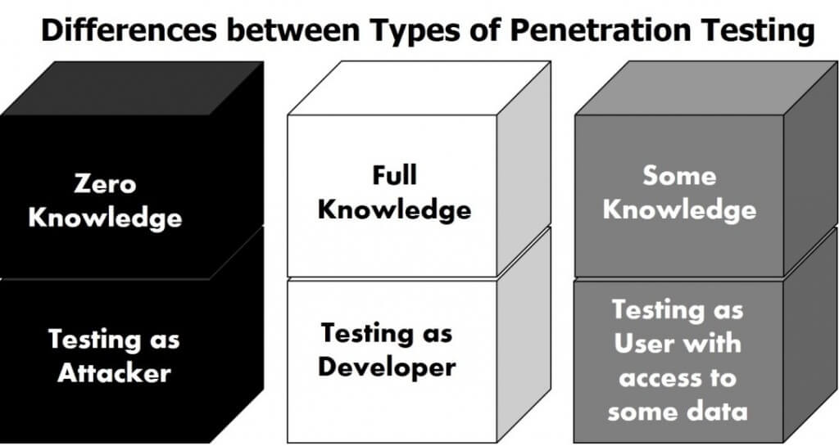
Nilina Bera

Slide 4
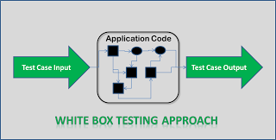
What is White Box Testing?
In white box testing methodology, the tester has the knowledge of the internals of a system and knows how the system is implemented.
The tester uses this knowledge to develop test cases that will examine the control flow, information flow, data flow, exception and error handling as well as coding practices of the system.
Nilina Bera

Slide 5
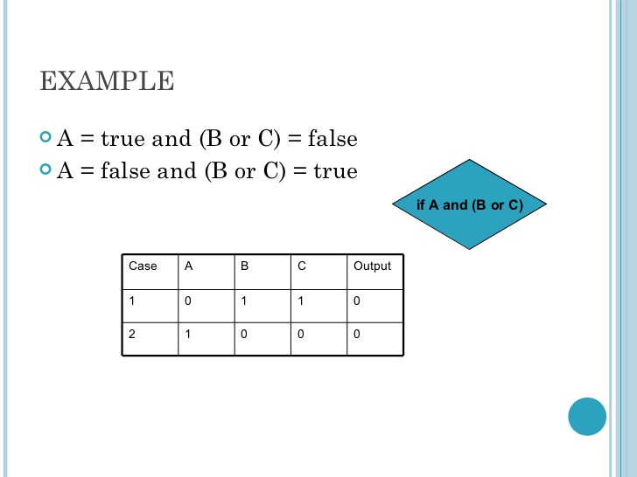
Nilina Bera

Slide 6
Techniques of White Box Testing
When it comes to white box testing, the knowledge that the tester possesses about the system is the driving factor, which helps the tester to devise test cases aimed at discovering defects with the internal working of the system.
Statement Tests: All the statements within the code must have a test case associated with it such that each statement must be executed at least once during the testing cycle.
Decision Tests: All the decision directions must be executed at least once during the testing life cycle.
Branch Condition Tests: All the conditions in a specific decision must be tested for proper working at least once.
Decision/Condition Tests: All the combination of the possible conditions within a specific decision for all the decisions is to be tested.
Data Flow Tests: This will ensure that all the variables and data that are used within the system are tested by passing the specific variables through each possible calculation.
Multiple Condition Tests: This will ensure that each point of entry with in the code is tested at least once during the testing life cycle.
Actually, we are going to learn statement coverage, branch coverage, path coverage and condition coverage of a program written by a developer….
Nilina Bera

Slide 7
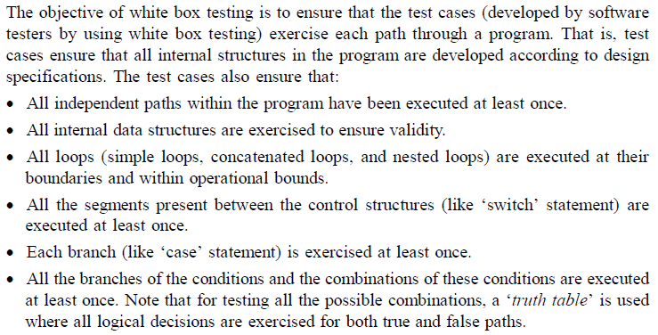
TESTING TECHNIQUES
Nilina Bera

Slide 8
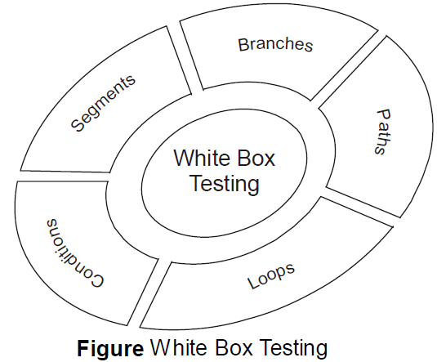
TESTING TECHNIQUES
Nilina Bera

Slide 9
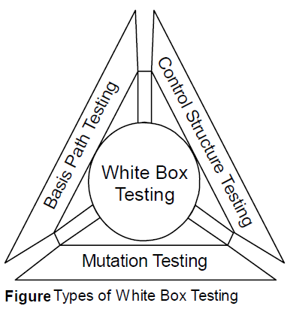
TESTING TECHNIQUES
The effectiveness of white box testing is commonly expressed in terms of test or code coverage metrics, which measure the fraction of code exercised by test cases. The various types of testing, which occur as part of white box testing are basis path testing, control structure testing, and mutation testing.
Nilina Bera

Slide 10
Basis Path Testing:
Basis path testing enables the software tester to generate test cases in order to develop a logical complexity measure of a component-based design (procedural design). This measure is used to specify the basis set of execution paths. Here, logical complexity refers to the set of paths required to execute all statements present in the program.
Note that test cases are generated to make sure that every statement in a program has been executed at least once.
Path Coverage :
Design test cases such that:
  all linearly independent paths in the program are executed at least once.
Nilina Bera

Slide 11
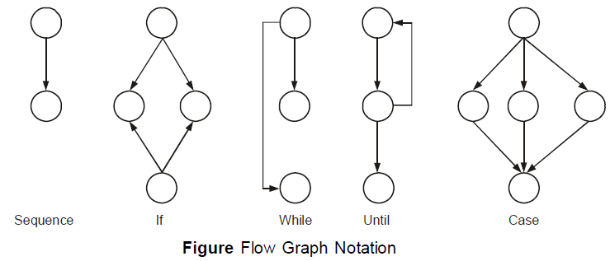
Creating Flow Graph:
Flow graph is used to show the logical control flow within a program. To represent the control flow, flow graph uses a notation which is shown in the following Figure:
Nilina Bera

Slide 12
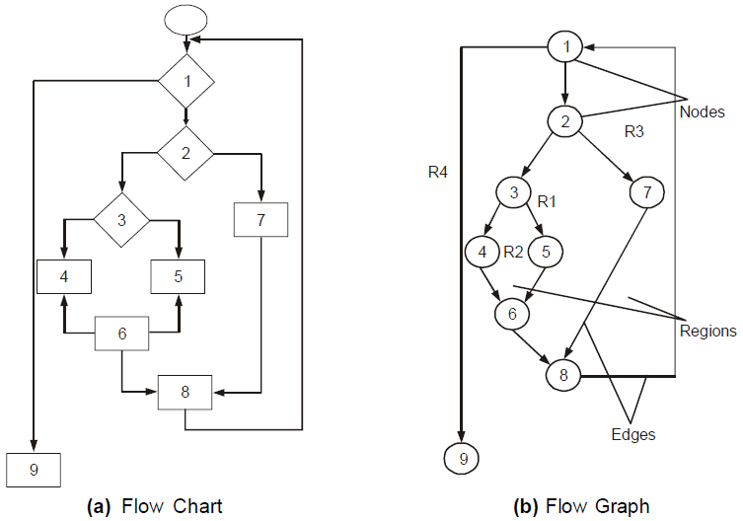
Flow chart + Flow Graph
Independent Path + Cyclomatic Complexity from this flow graph
Figure X
Nilina Bera

Slide 13
Finding Independent Paths:
A path through the program, which specifies a new condition or a minimum of one new set of processing statements, is known as an independent path.
For example, in nested ‘if’ statements there are several conditions that represent independent paths.
Note that a set of all independent paths present in the program is known as basis set.
A test case is developed to ensure that all the statements present in the program are executed at least once during testing. For example, all the independent paths in Figure X are listed below:
P1: 1 – 9
P2: 1 – 2 – 7 – 8 – 1 – 9
P3: 1 – 2 – 3 – 4 – 6 – 8 – 1 – 9
P4: 1 – 2 – 3 – 5 – 6 – 8 – 1 – 9
where ‘P1’, ‘P2’, ‘P3’, and ‘P4’ represents different independent paths present in the program.
Note that a node that contains a condition is known as predicated node, which contains one or more edges emerging out of it. For example, in Figure X, node 1, 2 and node 3 represent the predicated nodes.
Nilina Bera

Slide 14
Cyclomatic Complexity
The number of independent paths present in the program is calculated using cyclomatic complexity, which is defined as the software metric that provides quantitative measure of the logical complexity of a program.
This software metric also provides information about the number of tests required to ensure that all statements in the program are executed at least once.
Cyclomatic complexity can be calculated by using any of the three methods listed below:
The total number of regions present in the flow graph of a program represents the cyclomatic complexity of the program. For example, in Figure X, there are four regions represented by ‘R1’, ‘R2’, ‘R3’, and ‘R4’, hence, the cyclomatic complexity is four.
2. Cyclomatic complexity can be calculated according to the formula given:
CC = E – N + 2, where, ‘CC’ represents the cyclomatic complexity of the program, ‘E’ represents the number of edges in the flow graph, and ‘N’ represents the number of nodes in the flow graph.
For example, in Figure X, ‘E’ = ‘11’, ‘N’ = ‘9’. Therefore, CC = 11 – 9 + 2 = 4.
Nilina Bera

Slide 15
Cyclomatic Complexity
3. Cyclomatic complexity can be also calculated according to the formula given: CC = P + 1
where ‘P’ is the number of predicate nodes in the flow graph.
For example, in Figure X, P = 3. Therefore, CC = 3 + 1 = 4.
Deriving Test Cases:
In this, basis path testing is presented as a series of steps and test cases are developed to ensure that all statements present in the program are executed during testing.
While performing basis path testing, initially the basis set (independent paths in the program) is derived.
The basis set can be derived using the steps given below:
Nilina Bera

Slide 16
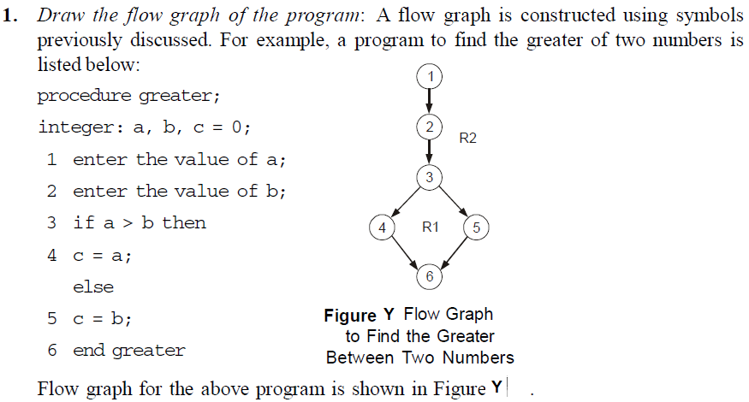
Deriving Test Cases:
Nilina Bera

Slide 17
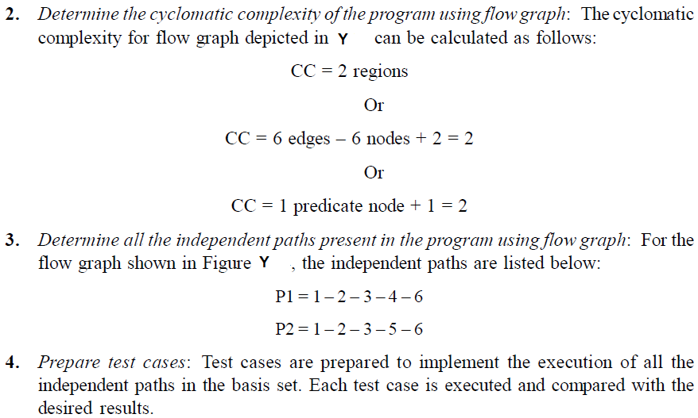
Deriving Test Cases:
Nilina Bera

Slide 18
White-Box Testing
There exist several popular white-box testing methodologies:
  Statement coverage (will cover….)
  branch coverage (will cover….)
  path coverage (already covered…)
  condition coverage (will cover….)
  mutation testing
  data flow-based testing
Nilina Bera

Slide 19
Statement Coverage
Statement coverage methodology:
  design test cases so that
    every statement in a program is executed at least once.
The principal idea:
  unless a statement is executed,
  we have no way of knowing if an error exists in that statement.
Nilina Bera

Slide 20
Statement coverage criterion
Based on the observation:
  an error in a program can not be discovered:
    unless the part of the program containing the error is executed.
Observing that a statement behaves properly for one input value:
  no guarantee that it will behave correctly for all input values.
Nilina Bera

Slide 21
Example
int f1(int x, int y){
1 while (x != y){
2 if (x>y) then
3 x=x-y;
4 else y=y-x;
5 }
6 return x; }
By choosing the test set {(x=3,y=3), (x=4,y=3), (x=3,y=4), (x=-4,y=-3), (x=-3, y=-4)}
  all statements are executed at least once.
Nilina Bera

Slide 22
Branch Coverage
Test cases are designed such that:
  different branch conditions
    given true and false values in turn.
Branch testing guarantees statement coverage:
  It is a stronger testing compared to the statement coverage-based testing.
What is Stronger testing? Test cases are a superset of a weaker testing:
  discovers at least as many errors as a weaker testing
  contains at least as many significant test cases as a weaker test.
Nilina Bera

Slide 23
Example
int f1(int x,int y){
1 while (x != y){
2 if (x>y) then
3 x=x-y;
4 else y=y-x;
5 }
6 return x; }
Test cases for branch coverage can be:
{(x=3,y=3), (x=3,y=2), (x=4,y=3), (x=3,y=4)}
Nilina Bera

Slide 24
Condition Coverage
Test cases are designed such that:
  each component of a composite conditional expression
    given both true and false values.
Consider the conditional expression
  ((c1.and.c2).or.c3):
Each of c1, c2, and c3 are exercised at least once,
  i.e. given true and false values.
Nilina Bera

Slide 25
Branch testing
Branch testing is the simplest condition testing strategy:
  compound conditions appearing in different branch statements
    are given true and false values.
Condition testing
  stronger testing than branch testing:
Branch testing
  stronger than statement coverage testing.
Nilina Bera

Slide 26
Example:
Consider a boolean expression having n components:
  for condition coverage we require 2^{n} test cases.
Condition coverage-based testing technique:
  practical only if n (the number of component conditions) is small (e.g., n=3).
Nilina Bera

Slide 27
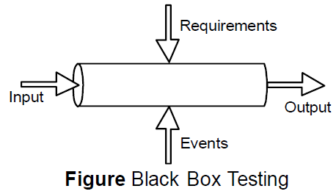
Black Box Testing
Black box testing, also known as functional testing, checks the functional requirements and examines the input and output data of these requirements. The functionality is determined by observing the outputs to corresponding inputs.
For example, when black box testing is used, the tester should only know the ‘legal’ inputs and what the expected outputs should be, but not how the program actually arrives at those outputs.
Nilina Bera

Slide 28
Black Box Testing
The black box testing is used to find errors listed below:
• Interface errors, such as functions, which are unable to send or receive data to/from other software.
• Incorrect functions that lead to undesired output when executed.
• Missing functions and erroneous data structures.
• Erroneous databases, which lead to incorrect outputs when software uses the data present in these databases for processing.
Incorrect conditions due to which the functions produce incorrect outputs when they are executed.
• Termination errors, such as certain conditions due to which function enters a loop that forces it to execute indefinitely.
Nilina Bera

Slide 29
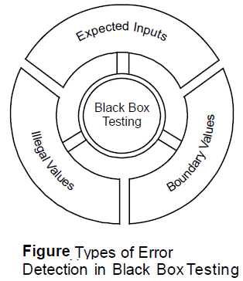
Black Box Testing
Nilina Bera

Slide 30
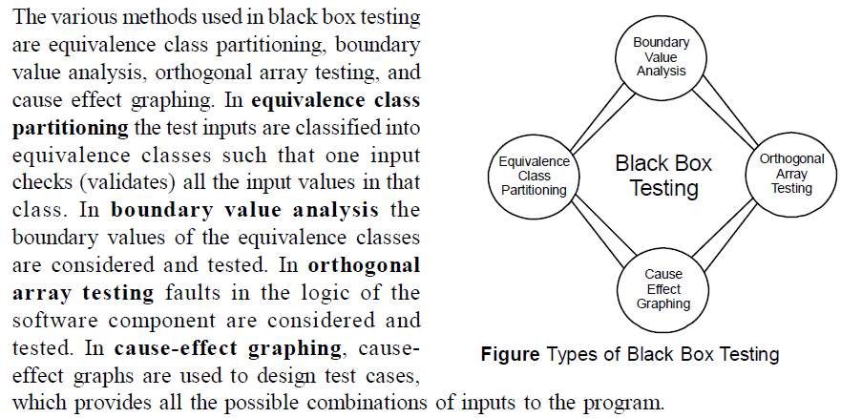
Black Box Testing
Nilina Bera

Slide 31
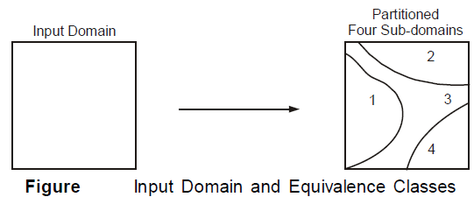
Equivalence Class Partitioning:
Equivalence class partitioning method tests the validity of outputs by dividing the input domain into different classes of data (known as equivalence classes) using which test cases can be easily generated.
Test cases are designed with the purpose of covering each partition at least once.
If a test case is able to detect all the errors in the specified partition, then the test case is said to be an ideal test case.
Nilina Bera

Slide 32
Equivalence Class Partitioning:
An equivalence class depicts valid or invalid states for the input condition.
An input condition can be either a specific numeric value, a range of values, a Boolean condition, or a set of values.
Nilina Bera

Slide 33
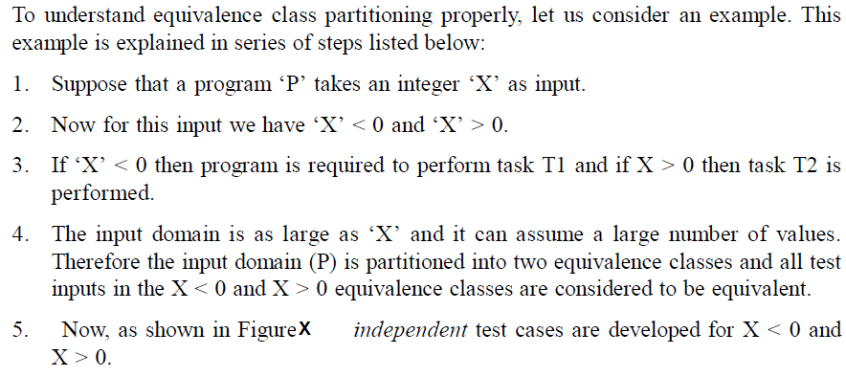
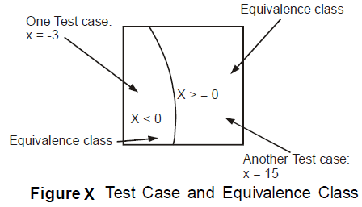
Nilina Bera

Slide 34
Boundary Value Analysis
Boundary value analysis (BVA) is a black box test design technique where test cases are designed based on boundary values (that is, test cases are designed at the edge of the class).
Boundary value can be defined as an input value or output value, which is at the edge of an equivalence partition or at the smallest incremental distance on either side of an edge, for example the minimum or maximum value of a range.
Nilina Bera

Slide 35
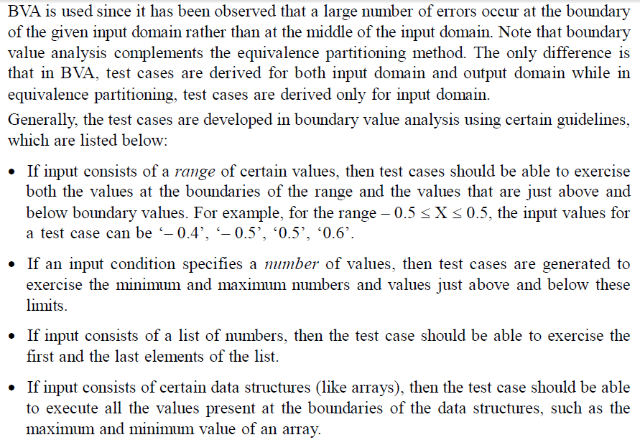
Nilina Bera

Slide 36
Cause-Effect Graphing
Cause-effect graphing is a test design technique where test cases are designed using cause-effect graphs.
A cause-effect graph is a graphical representation of inputs and/or stimuli (causes) with their associated outputs (effects), which can be used to design test cases.
Test cases are generated to test all the possible combinations of inputs provided to the program being tested.
One of the major drawbacks of using equivalence partitioning and boundary value analysis is that both these methods test every input given to a program independently.
This drawback is avoided in cause effect graphing where combinations of inputs are used instead of individual inputs.
To use cause effect graphing method, a number of steps are followed, which are listed below:
Nilina Bera

Slide 37
Cause-Effect Graphing
1. List the cause (input conditions) and effects (outputs) of the program.
2. Create a cause-effect graph.
3. Convert graph into decision table.
4. Modify decision table rules to test cases.
For generating test cases, initially, all causes and effects are allocated unique numbers,
which are used to identify them.
After allocating numbers, the cause due to which a particular effect occurred is determined.
Next, the combinations of various conditions that make the effect ‘true’ are recognized.
A condition has two states, ‘true’ and ‘false’.
A condition is ‘true’ if it causes the effect to occur, otherwise it is ‘false’.
The conditions are combined using Boolean operators, such as ‘AND’ (&), ‘OR’ (|) and ‘NOT’ (~).
Finally, a test case is generated for all possible combinations of conditions.
Nilina Bera

Slide 38
Gray Box Testing
Gray box testing does not require full knowledge of the internals of the software that is to
be tested instead it is a test strategy, which is based partly on the internals.
This testing technique is often defined as a mixture of black box testing and white box testing techniques.
Gray box testing is especially used in web applications, because these applications are built around loosely integrated components that connect through relatively well-defined interfaces.
Testing in this methodology is done from the outside of the software similar to black box
testing.
However, testing choices are developed through the knowledge of how the underlying components operate and interact.
Some points noted in gray box testing are listed below:
• Gray box testing is platform and language independent.
• The current implementation of gray box testing is heavily dependent on the use of a host platform debugger(s) to execute and validate the software under test.
• Gray box testing can be applied in real-time systems.
• Gray box testing utilizes automated software-testing tools to facilitate the generation of
test cases.
• Module drivers and stubs are created by automation means thus, saving time of testers.
Nilina Bera

Slide 39
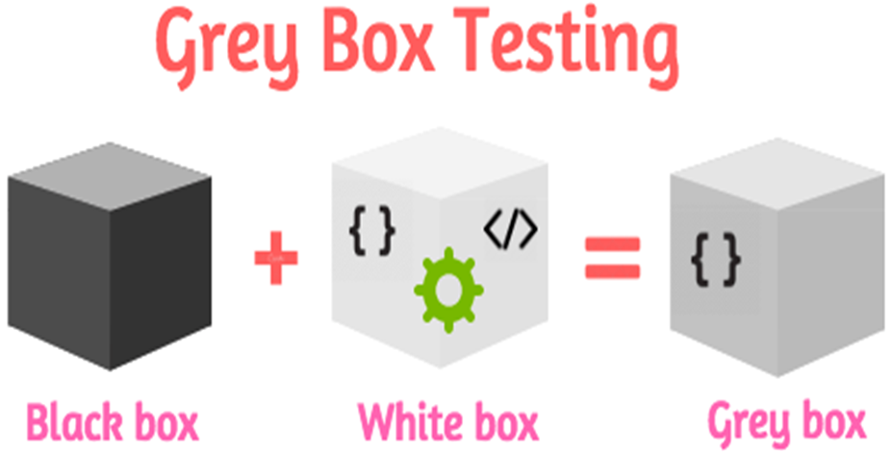
Nilina Bera

Slide 40

Testing Done….. Questions – n – Answers done…. ?????
Nilina Bera

